Slide 1

Country of the blind (and lame): networking (and updating) devices without user interfaces
— SZ-VS-MS
COM3505, Lecture 4
Prof Hamish Cunningham

Slide 2
~⅓ in: seasonally affected? low energy?
The Economist on the IoT: Chips with Everything, Sept. 14th 2019 (behind £wall, see notes for quotes):
‘One way to think of it is as the second phase of the internet... Attracted by the lure of new business, and fearful of missing out, firms are piling in... Microsoft, Dell, Intel and Huawei ... competing and co-operating with older industrial firms: Siemens, a German industrial giant, has been on an iot acquisition spree ... Consumer brands are scrambling, too: Whirlpool, the world’s biggest maker of home appliances ...
... telecoms firms are keen to find new, higher-margin businesses rather than simply acting as “bit pipes”, so they have built smart-home offerings as well. Vodafone ... SK Telecom, AT&T ... even British Gas ...
... the assumption was that smart homes would be controlled from phones. But ... “Pulling out your phone, unlocking it, tapping an app, then using it to turn the lights on, is much more complicated and annoying than simply walking across the room and pushing a button”. Voice, he says, is by far the most convenient user-interface. Amazon’s Alexa and Google Home, the two firms’ smart-speaker products, already have greater market penetration than rival smart-home hubs.’
massive expansion + novel UI requirements / questionable security = opportunity
How to…? (The story of Chico, the IRF and the Large Data Collider…)

Slide 3
Demo: privacy-preserving open source AI for IoT speech2speech (safe, ish) control tasks
…

Slide 4
AI + IoT for smart homes….
The Transformer models that have been trained on the biggest datasets are proving to be a step-change in conversational AI. ChatGPT is the best known at present, and is extremely effective at appearing to be a lucid dialogue partner or (via GitHub co-pilot) a knowledgeable pair programming companion. This is an application of some of the largest computations over the largest data sets that have ever been achieved. Many things are set to change as a result.
The Internet of Things (IoT), on the other hand, is about the application of our smallest units of computation in networked microcontrollers. Special purpose devices combine sensors and actuators, expose control surfaces of various types, and communicate with local hubs and/or cloud analytics and control. A common application area of IoT tech is in domestic automation or smart homes, but the privacy implications and the brittle failure profiles of the devices inhibit takeup.
This project is about privacy-preserving conversational LLMs in a smart home context. Privacy is facilitated using versions of the technology that don't require cloud processing and can run without an external network connection. Conversational inference can make control tasks less brittle and more human. Open source applications of (semi-open) LLMs can go some way to giving back what has been taken to build the models?

Slide 5
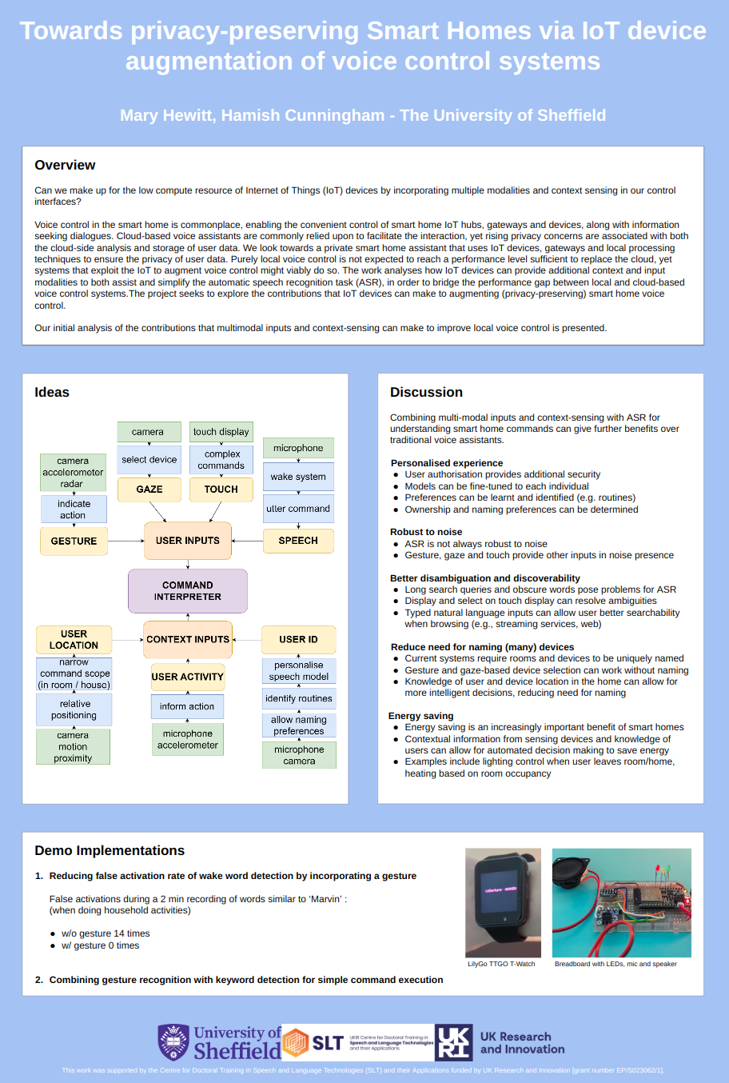
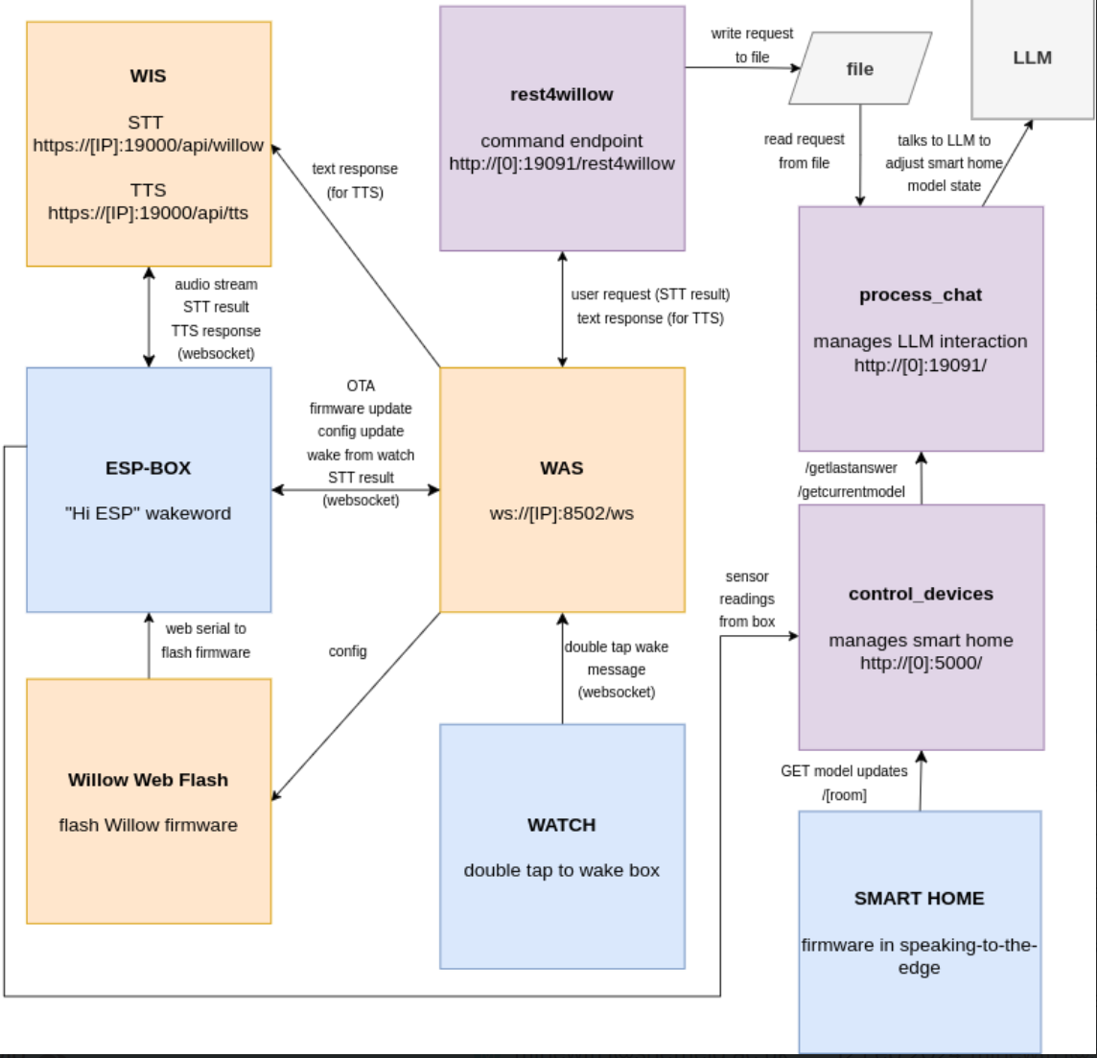

Slide 6
JSON model of a smart home:
{
"bathroom_light": "off",
"bedroom_humidifier": "off",
"bedroom_overhead_light": "off",
"dining_room_light": "off",
"doorbell_camera": "off",
"entrance_light": "off",
"front_door": "locked",
"hall_light": "off",
"heating_target_temperature": "15",
"kitchen_coffee_maker": "off",
"kitchen_overhead_light": "off",
"living_room_lamp": "off",
"living_room_overhead_light": "off",
"living_room_speaker": {
"state": "off", "volume": "5"
},
"living_room_tv": {
"state": "off", "volume": "5"
},
"living_room_window_blinds": "up",
"robot_vacuum_cleaner": "off"
}
Dealing with LLM hallucination and reasoning faults

Slide 7
Lecture 4
Contents
week 3 code review
provisioning (“in the country of the blind…”) devices without UIs
updating IoT devices over-the-air

Slide 8
[Week 3 review: Exercises 3—6 ]
Using the switch/LED breadboard, code and test the following: Ex03:
add more two more LEDs to your board
run as traffic lights, triggered by the switch
Coding infrastructure idioms:
Ex04: debugging infrastructure: experiment with macros to allow adding flexible debug code
Exercise 5 (Ex05) is about, ahem, multiprocessing… (loop slicing)
The WiFi stack: Ex06: becoming a wifi access point and web server using WiFi.h and ESPWebServer.h
9 LEDs breadboard

Slide 9
[ESP32 Firmware, the Story so Far (1: basic IO)]
// Ex03.h // add more LEDs and switches; run as traffic lights or individually #ifndef LAB_03_H #define LAB_03_H // LEDs are assigned to pins 32,15 and 12 const int red = 32; const int yellow = 15; const int green = 12; boolean ON_RED = false; #endif
// Ex03.ino void setup03() { setup02(); // previous setups... Serial.println("\nsetup03..."); // debug printout // set up further GPIO pins with nice names for additional external LEDs pinMode(yellow, OUTPUT); pinMode(green, OUTPUT); digitalWrite(green, HIGH); // we start the traffic light sequence on green } void loop03() { if (digitalRead(14) == LOW) { // if the switch is LOW, ie. pushed down Serial.printf(" ON_RED is %d; switch pressed...\n", ON_RED); changeLights(); // call this function to change the lights! } }
void changeLights() { if(ON_RED) { // red and yellow on for 2 seconds (red is already on though) digitalWrite(yellow, HIGH); delay(2000); // turn off red and yellow, then turn on green digitalWrite(yellow, LOW); digitalWrite(red, LOW); digitalWrite(green, HIGH); } else { // green off, yellow on for 3 seconds digitalWrite(green, LOW); digitalWrite(yellow, HIGH); delay(3000); // turn off yellow, then turn red on for 5 seconds digitalWrite(yellow, LOW); digitalWrite(red, HIGH); } ON_RED = ! ON_RED; }

Slide 10
[ESP32 Firmware, the Story so Far (2: debug idiom)]
// Ex04.h: debugging infrastructure #ifndef LAB_04_H #define LAB_04_H // setting different DBGs true triggers prints #define dbg(b, s) if(b) Serial.print(s) #define dln(b, s) if(b) Serial.println(s) #define startupDBG true #define loopDBG true #define monitorDBG false #define netDBG true #define miscDBG true #define analogDBG false #endif
(See also the inbuilt ESP IDF and Arduino core macros, e.g. log_w, log_e, …)
// Ex04.ino // setup and loop /////////////////////////////////////////////////////////// void setup04() { setup03(); // previous setups: get the MAC, set up GPIO pins, ... dln(startupDBG, "\nsetup04..."); // debug printout on serial, with newline } void loop04() { dbg(loopDBG, "ESP32 MAC = "); // print the... dln(loopDBG, MAC_ADDRESS); // ...ESP's "ID" blink(3); // blink the on-board LED... delay(1000); // ...and pause }

Slide 11
[ESP32 Firmware, the Story so Far (3: control idiom)]
// Ex05.h: loop slicing #ifndef LAB_05_H #define LAB_05_H unsigned long firstSliceMillis; // what time did we start? unsigned long lastSliceMillis; // what time did we last run this action? int loopIteration = 0; // a control iterator for slicing up the main loop const int LOOP_ROLLOVER = 25000000; // # loops per action seq #endif // Ex05.ino void setup05() { setup04(); // previous setups: get MAC, set up GPIO pins, ... dln(startupDBG, "\nsetup05..."); // debug printout on serial, with newline firstSliceMillis = millis(); // remember when we began lastSliceMillis = firstSliceMillis; // an approximation to use in first loop } void loop05() { // Q what types of timings do different slices equate to? int sliceSize = 1000000; int TICK_DO_SOMETHING = 1; int TICK_DO_SOMETHING_ELSE = 9999999; // actions on individual iterations ...
if(loopIteration == TICK_DO_SOMETHING) { // do task for this iteration dbg(loopDBG, "doing something, loopIteration number = "); dln(loopDBG, loopIteration); } else if(loopIteration == TICK_DO_SOMETHING_ELSE) { // other task... dbg(loopDBG, "doing something else, loopIteration number = "); dln(loopDBG, loopIteration); } // actions on each X slices if(loopIteration % sliceSize == 0) { // a slice every sliceSize iterations dbg(loopDBG, "loopIteration number = "); dbg(loopDBG, loopIteration); dbg(loopDBG, ", slice lasted "); dbg(loopDBG, millis() - lastSliceMillis); dbg(loopDBG, " milliseconds"); dbg(loopDBG, "; slice size is "); dln(loopDBG, sliceSize); lastSliceMillis = millis(); } // roll over (alternative: just let the counter overflow...) if(loopIteration++ == LOOP_ROLLOVER) { loopIteration = 0; dbg(loopDBG, "loopIteration rolling over; "); dbg(loopDBG, LOOP_ROLLOVER); dbg(loopDBG, " loops lasted "); dbg(loopDBG, millis() - firstSliceMillis); dln(loopDBG, " milliseconds...; rolling over"); } } // loop05()

Slide 12
ESP32 Firmware, the Story so Far (4: APs & HTTP)
// Ex06.h: starting up a wifi access point and web server #ifndef LAB_06_H #define LAB_06_H #include <WiFi.h> #include <ESPWebServer.h> String apSSID; // SSID of the AP ESPWebServer webServer(80); // a simple web server #endif // Ex06.ino void setup06() { setup05(); // previous setups... dln(startupDBG, "\nsetup06..."); // debug printout on serial startAP(); // fire up the AP... startWebServer(); // ...and the web server } void loop06() { // things to try: how responsive is it with different time slicing options? // or what if we add in "loop02();"...? what if there are mulitple requests? // how might this compare with responsiveness on the ESP8266? if(! (loopIteration++ % 1000 == 0)) return; // a slice every 1k iterations dln(netDBG, "calling webServer.handleClient()..."); webServer.handleClient(); // deal with any pending web requests }
void startAP() { apSSID = String("Thing-"); apSSID.concat(MAC_ADDRESS); if(! WiFi.mode(WIFI_AP_STA)) dln(startupDBG, "set Wifi mode failed"); if(! WiFi.softAP(apSSID.c_str(), "dumbpassword")) dln(startupDBG, "failed to start soft AP"); } void startWebServer() { // register callbacks to handle different paths webServer.on("/", handleRoot); // ".../" /* … */ webServer.begin(); } String getPageTop() { // page creation utils (for better ones see Ex07!) return "<html><head><title>COM3506 IoT [ID: " + apSSID + "]</title>\n" /* … */ void handleNotFound() { // webserver handler callbacks ... webServer.send(200, "text/plain", "URI Not Found"); } void handleRoot() { String toSend = getPageTop(); toSend += getPageBody(); toSend += getPageFooter(); webServer.send(200, "text/html", toSend); } void handleHello() { /* ... */ }

Slide 13
Lecture 4
Contents
week 3 code review
provisioning (“in the country of the blind…”) devices without UIs
updating IoT devices over-the-air

Slide 14

Headless Device Provisioning
Unwrap your shiny new thing and connect it to…?
Either:
the device has to ship with network credentials, or
support end-user configuration
Options...
Notes:
https://ak2.picdn.net/shutterstock/videos/10704062/thumb/8.jpg
receiving a shiney new thing
how to connect?
- wifi: you've just done that, and we'll review it in some detail next
- first, other methods: sifgox, lorawan, ....

Slide 15
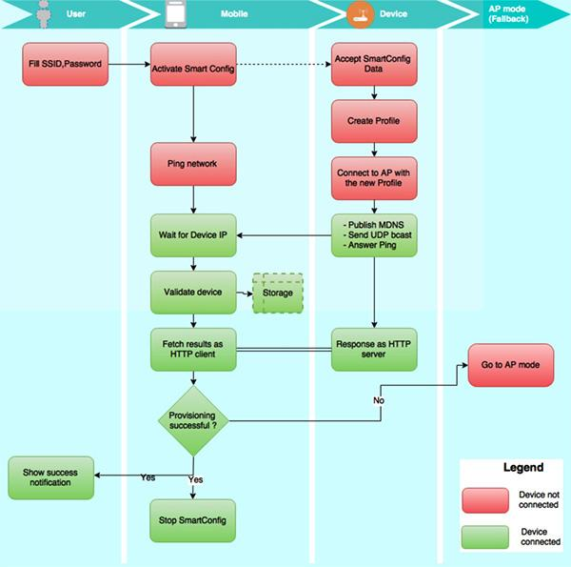
Wifi-based provisioning
Options:
WiFi Protected Setup (WPS) — some forms shown to be crackable in 2011, now often disabled
SmartConfig — mostly TI only, and the non-AES version relies on security by obscurity (ouch!), but AES version is secure (ish?!)
device as access point:: AP running WPA + HTTP(S) / SSL = as secure as normal wifi & web (!)
various phone apps using BlueTooth
This week: option 3., AP + HTTPD
SmartConfig flow:
Notes:
https://www.digikey.com/en/articles/techzone/2017/may/a-simpler-solution-hardening-security-wi-fi-connected-iot-designs

Slide 16
Labs: how to network a device without a UI?
To turn a thing (embedded electronics based on microcontrollers, sensors and actuators) into an internet thing we need to connect to the network.
If the device has no user interface, how do we allow users to configure the network?
Ex08: become a web client and send your email & the MAC address of your ESP to our server (see 4.2.2.3 and Blackboard for URL)
use the WifiClient class from the WiFi library
Ex09: adapting Ex07/08 to allow connection of device to arbitrary networks (=provisioning)
in Ex07 you (or model code!) created a wifi access point and served HTML pages
using the WiFi.scanNetworks() method, serve HTML to list available APs, and allow user to choose one, enter key, and have the ESP connect to that network
Ex07: simple utilities for representing and manipulating HTML elements and serving pages

Slide 17
Ex 9: WiFi provisioning
Simple access point device provisioning (aka Ex09):
the ESP provides an access point, called e.g. Thing-MY-MAC-ADDR
users connect to that access point using a phone or laptop or etc., and:
either they navigate to a known IP address (192.168.4.1 by default), or
the ESP may run a captive portal DNS (replies to all requests with the IP of a configuration server, or sign in server)
the ESP also runs a webserver, which lists other wifi APs and allows entry of access keys
when configured with the correct credentials, the ESP connects to an AP as a client (and can shut down its own AP as required)

Slide 18
Summary: WiFi provisioning
ESP32
USER join wifi request any website list of available wifi APs choose AP, enter key, POST switch to cloud or other UI
advertise wifi AP
...
DNS * to AP IP
...
HTTP 200
...
restart wifi as client of AP
...
(optionally) shut down AP

Slide 19
Lecture 4
Contents
week 3 code review
provisioning (“in the country of the blind…”) devices without UIs
updating IoT devices over-the-air

Slide 20
[Click Here to Kill Everybody (again)]
“Everything is a computer. Ovens are computers that make things hot; refrigerators are computers that keep things cold. These computers—from home thermostats to chemical plants—are all online. The Internet, once a virtual abstraction, can now sense and touch the physical world.
As we open our lives to this future, often called the Internet of Things, we are beginning to see its enormous potential in ideas like driverless cars, smart cities, and personal agents equipped with their own behavioral algorithms. But every knife cuts two ways.
All computers can be hacked. And Internet-connected computers are the most vulnerable. Forget data theft: cutting-edge digital attackers can now crash your car, your pacemaker, and the nation’s power grid.”
Click Here to Kill Everybody: Security and Survival in a Hyper-connected World — Bruce Schneier, Sept 2018

Slide 21
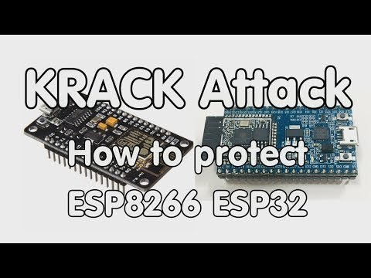
[An aside: KRACK — patch your machines now!]
“KRACK (Key Reinstallation Attack) ... on the WPA ... By repeatedly resetting the nonce transmitted in the third step of the WPA2 handshake, an attacker can gradually match encrypted packets seen before and learn the full keychain used to encrypt the traffic.” (Wikipedia)
(don’t panic, this was 2017!)

Slide 22
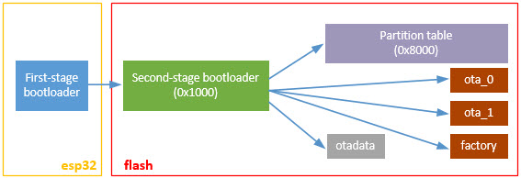
How to ensure IoT devices get patched when security holes appear?
OTA: over-the-air updates
when your microcontroller is connected via a fast network (e.g. over WiFi), it can download new firmware versions whenever they’re available
Q: what are the implications for flash memory resources on the device?
if you corrupt your firmware, you’ve “bricked” your device
OTA updates, where the net might suddenly drop, must be staged in separate space on flash — so the available flash memory must be double (or triple) the size of a single flash image
http://www.lucadentella.it/en/2016/12/22/esp32-4-flash-bootloader-e-freertos/

Slide 23
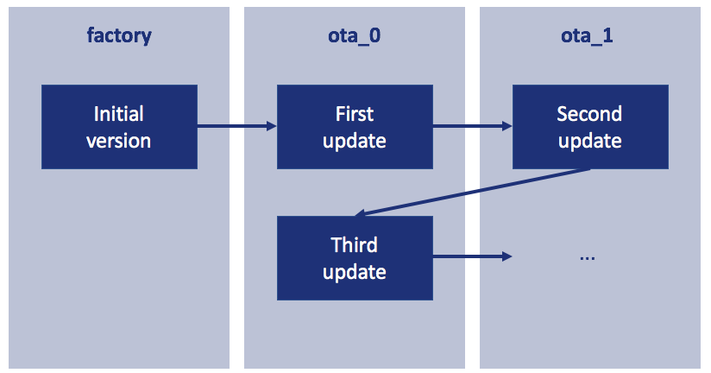
OTA updates (2)
Sequence:
firmware (.bin) and version # published to web
ESP polls web; if version > current firmware version:
download new firmware to free flash partition
verify download; set bootloader flag to the new partition
restart, new version runs
https://blog.classycode.com/over-the-air-updating-an-esp32-29f83ebbcca2

Slide 24
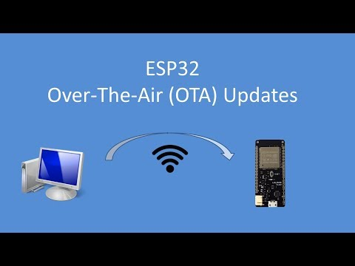
OTA updates (3)
The Arduino IDE supports OTA, accessible via the Tools>Port menu option when running an OTA capable sketch and connected to the same network as the ESP.
See the File>Examples>ArduinoOTA>BasicOTA example sketch.
(This only works via the IDE, so not
too useful in practice!)

Slide 25
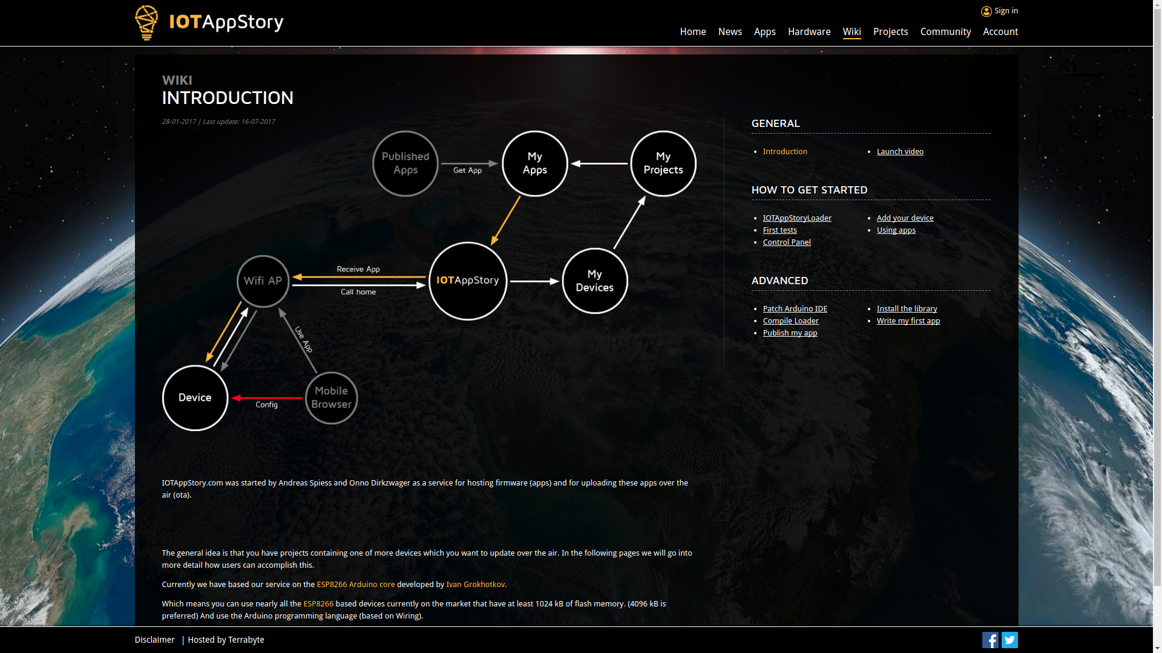
[AP-based config + OTA = ….?]
IoTAppStory.com from our friend Andreas Spiess:
device polls firmware repo
when updates available triggers OTA update
IoT app store model… (originally ESP8266, recently ported to ESP32)

Slide 26

[IoTAppStory (2)]

Slide 27
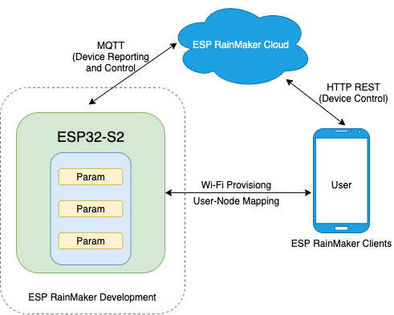
RainMaker: Espressif Provisioning and OTA
from IDF 4.0 and above Espressif provide an official solution
call the library from app_main, specify parameters to twiddle on the device
specify firmware repository for OTA
manage the device from your phone
+ves:
(fairly!) stable, efficient, Android and iOS support
-ves:
relies on Espressif cloud (hosted on AWS), or £expensive

Slide 28
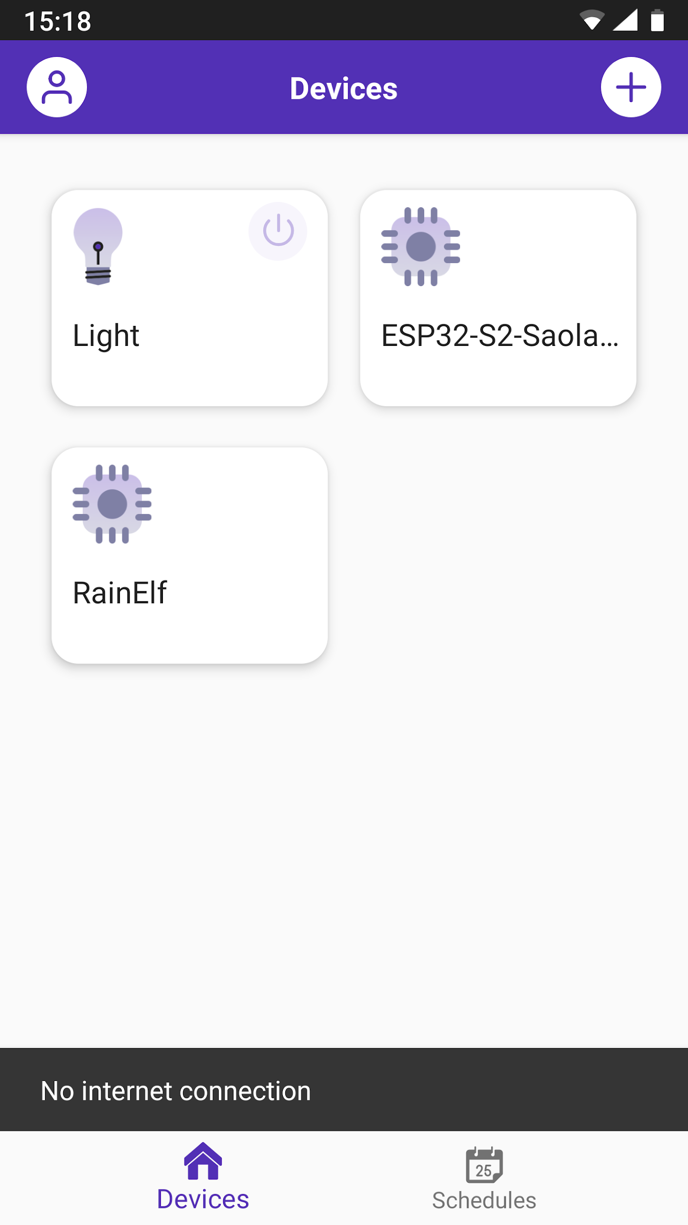
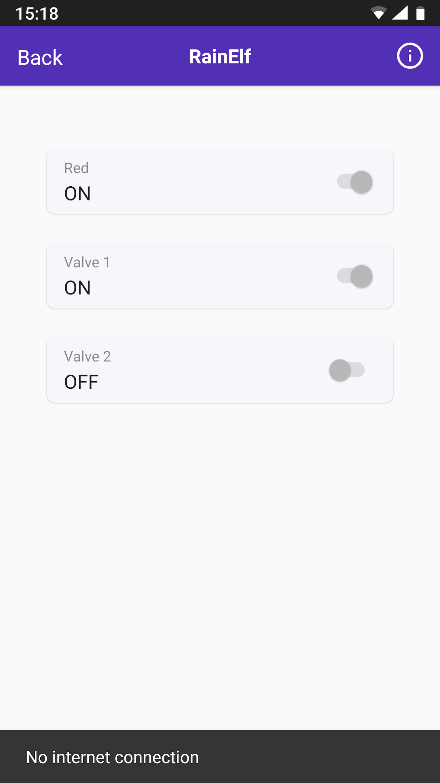
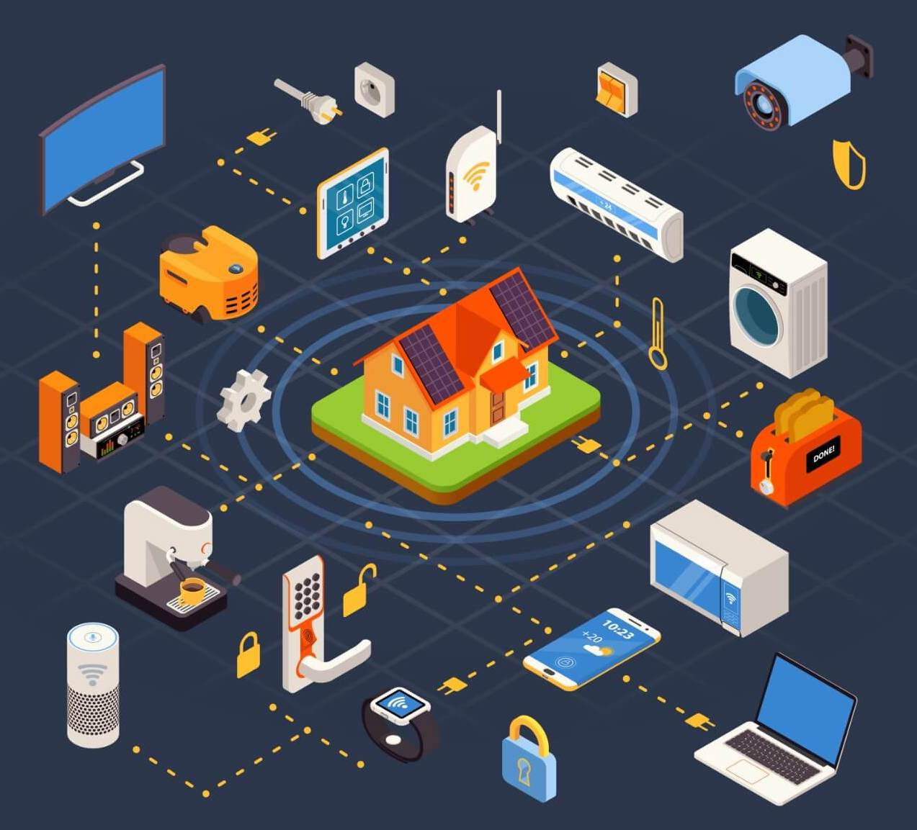
RainMaker (2): autoconfigured control

Slide 29
[It doesn’t /The heart of the/A bad pun] Matter
Please give me a short introductory paragraph to the new Matter IoT standard, and then describe how it supports provisioning and OTA.
Matter is a new standard for the Internet of Things (IoT) that aims to make smart home devices more interoperable and secure. It was developed by the Connectivity Standards Alliance (formerly known as the Zigbee Alliance) in collaboration with major tech companies such as Apple, Google, Amazon, and Samsung. Matter builds on existing IoT standards, such as Zigbee and Thread, and uses the IP protocol to provide a common language for smart devices. With Matter, users can easily connect and control a wide range of smart devices from different manufacturers, without the need for additional hubs or bridges.
Matter also supports two key features for IoT devices: provisioning and over-the-air (OTA) updates….
[your friendly neighbourhood AI, Feb 2023]
(do we trust this? what’s different from Wikipedia or random search? ….?)

Slide 30
[It doesn’t /The heart of the/A bad pun] Matter
Please give me a short introductory paragraph to the new Matter IoT standard, and then describe how it supports provisioning and OTA.
Matter is a new IoT standard developed by the Connectivity Standards Alliance (CSA), a group of leading technology companies. Matter aims to simplify the development and deployment of IoT devices and applications by providing a single, interoperable protocol that works across different platforms and ecosystems. One of the key features of Matter is its support for provisioning and over-the-air (OTA) updates, which enable seamless device management and keep devices up-to-date with the latest software and security patches. Matter supports provisioning through its use of the Thread Commissioning service. This service allows devices to be provisioned and configured automatically, without the need for physical access or manual setup. Devices can be provisioned using a variety of methods, including QR codes, NFC tags, or even remote provisioning via a mobile app. Matter also supports OTA updates …
[Vicuna 13B, Feb 2024]
(do we trust this? what’s different from Wikipedia or random search? ….?)

Slide 31
Your TODO list for week 4:
understand provisioning! understand OTA! (complex workflow!)
read chapter 4
coding: Ex07/08/09 (or some subset of!)
7: creating web pages
8: being a web client
9: provisioning
(OTA next week)

Slide 32
THE END

Slide 33
Old slides follow
(use them at your own risk!)

Slide 34
Clarification: “IDF” vs. “Arduino” for ESP32
The terms are ambiguous: both “IDF” and “Arduino” (or “Arduino core for ESP32”) refer to:
a build system
a set of APIs, libraries and firmware examples
Build systems:
for Arduino this is hidden behind the IDE
for IDF it is a command-line build using GNU make or CMake
both use the same xtensa compiler (based on the GNU suite, gcc)
both create a .bin as output
IDF is easier to layer other tools and editors on top of, and has an ESP-specific serial monitor (that e.g. decodes exceptions)
Arduino is easier to access examples and libraries
APIs:
Arduino is much more widespread and well-known; IDF more low level, potentially more efficient, and can exploit more of the particular properties of the ESP32

Slide 35
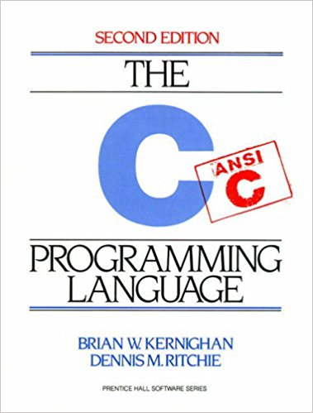
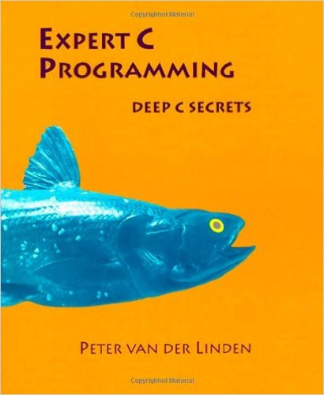
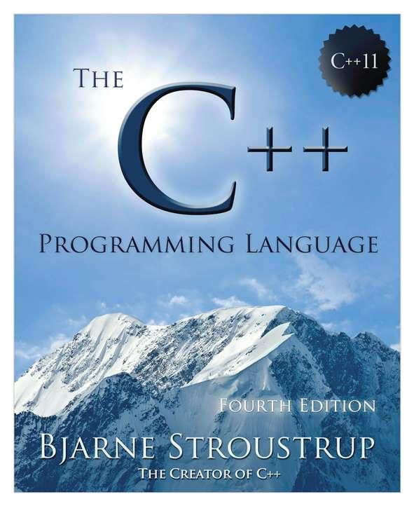
Deep C Secrets

Slide 36
OTA updates (4)
demo of model solution to this week’s exercise (and the assessment)

Slide 37
Easy peasy?
Who thought the exercises were too easy this week?
DON’T WORRY! The material is challenging (multiple servers, several access points, GitHub vs. cloud, device vs. desktop, etc.)! But if you manage to learn it well you will have conquered one of the biggest hurdles in IoT development (provisioning).
And you’ll be ahead of 99% of the game...
This week we will consolidate that knowledge and move on to the next hurdle...

Slide 38
ESP32 Firmware, the Story so Far: Summary
Weeks 1 — 3:
Thing.ino: code structure; lab exercise runner sketch
Ex01: printing on the serial line; blinking the built-in LED
Ex02: blinking an external LED; reading from a switch
Ex03: add more LEDs and switches; run as traffic lights or individually [OPT]
Ex04: debugging infrastructure [OPT]
Ex05: loop slicing
Week 4:
Ex06: becoming a wifi access point and web server
using WiFi.h and ESPWebServer.h fire up an access point and serve pages
Ex07 [OPT]: simple utilities for representing and manipulating HTML elements and serving pages

Slide 39
Provisioning in practice: Ex09
demo of model solution to Ex 09

